Slide 1


Greeny System
Presented by:
Reema Alsheikh
Shahad Alhazmi
Fahad Almusalam

Slide 2
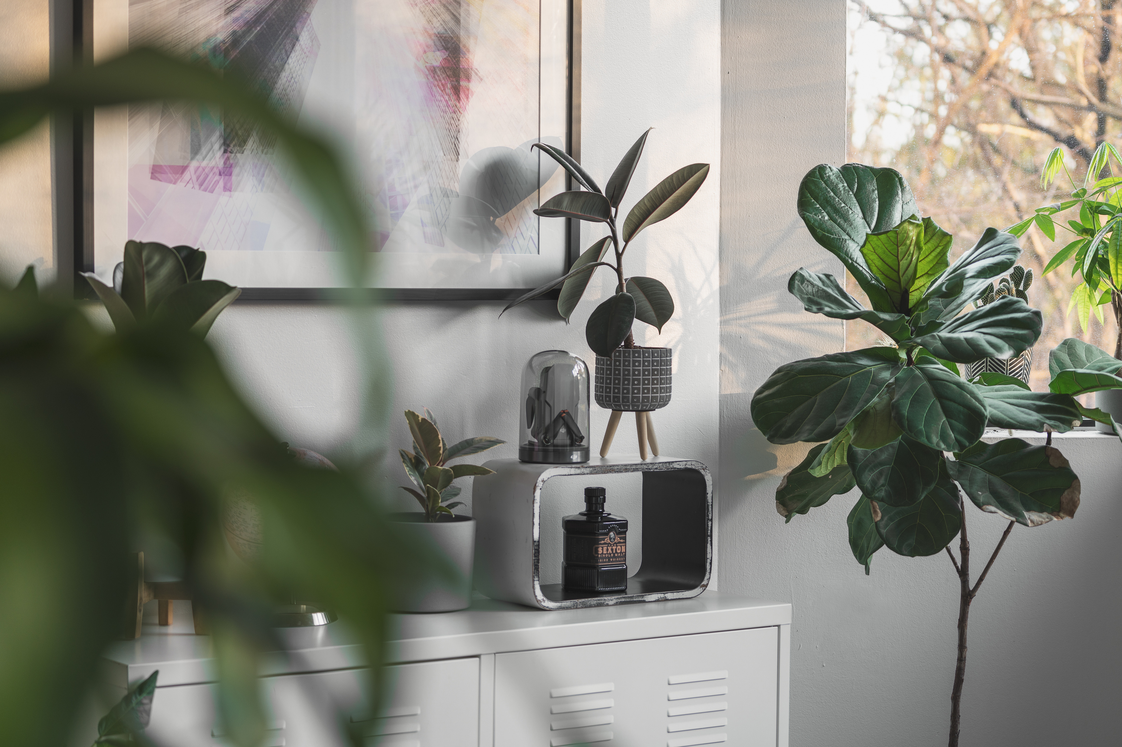
Agenda
Problem
Description
Solutions

Slide 3
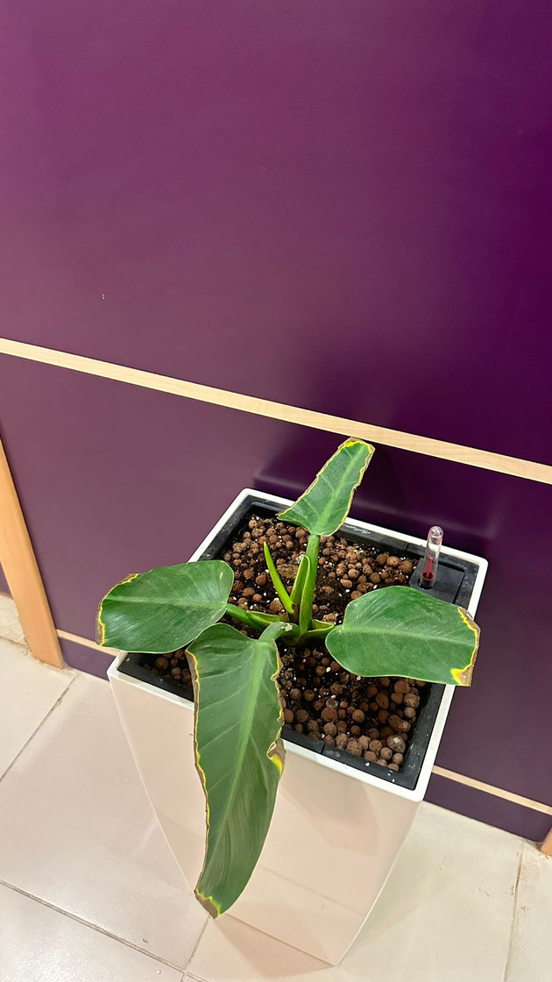
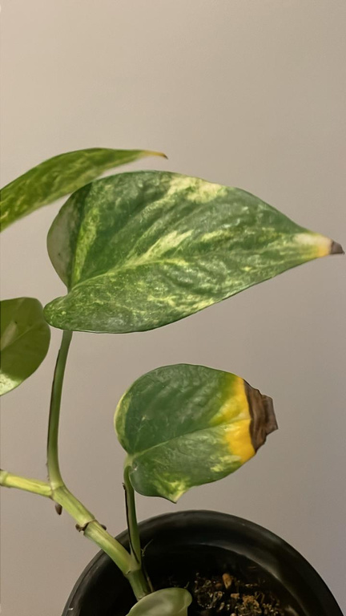
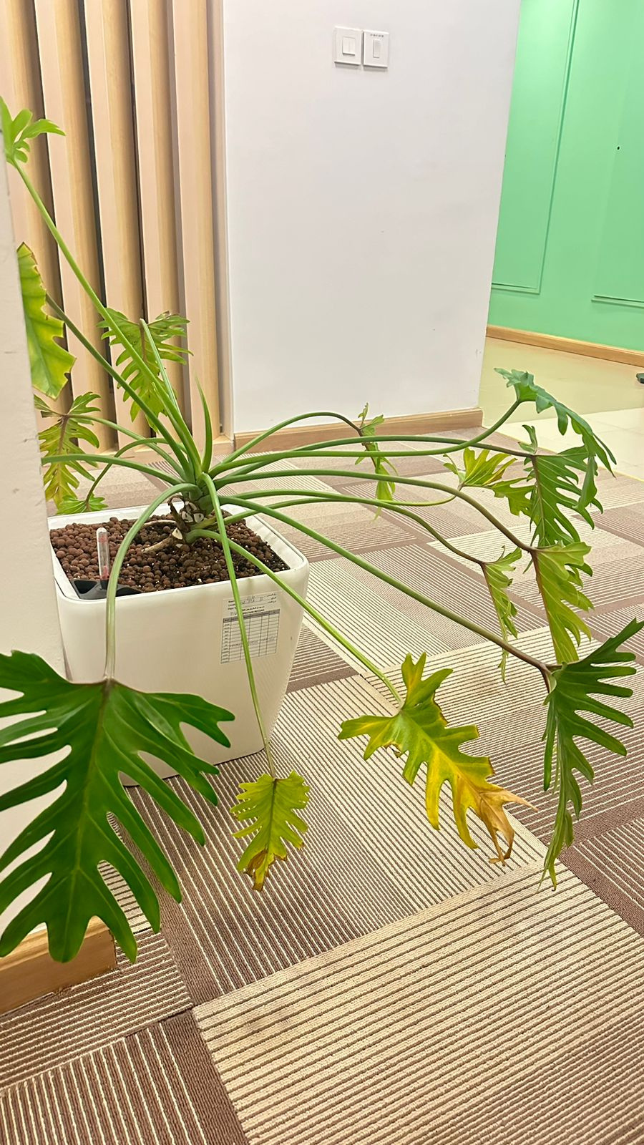
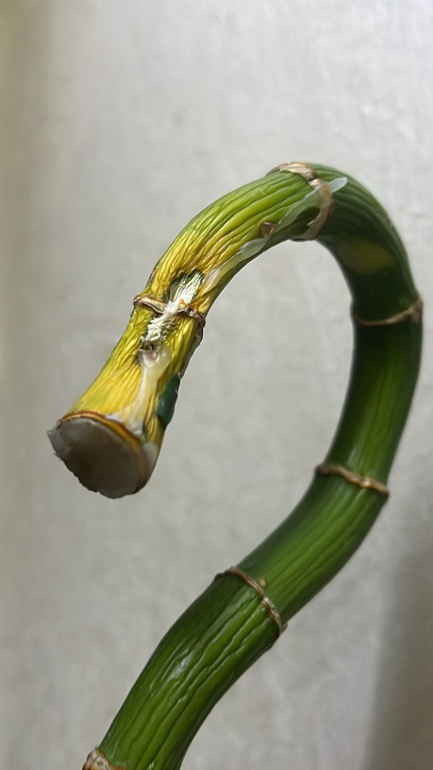
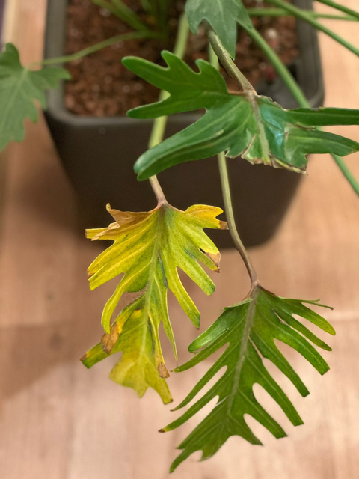
Problem

Slide 4

Description
Our Plants Website is a comprehensive platform designed to connect plant enthusiasts, gardeners, and professionals with the best tools, resources, and services for plant care and gardening. The website offers a wide range of plants, gardening tools, and expert consultations, creating a one-stop shop for all things related to plant care.

Slide 5


Solutions
Light Requirements
Water Requirements
Temperature Requirements
Soil Type Requirements
Planting Season
Growth Time

Slide 6
Solutions
Nurseries With Available Stock
Find Nurseries By Location
Creating the Order
Assign tools to order
Most popular plants
Order Review
Extend Consultation Duration

Slide 7
Solutions
Consent to consultation
User confirmation of completion of consultation
Consultant confirmation to complete the consultation
Complete the consultation
User cancels consultation

Slide 8
Thanks

